Slide 1


Revolutionizing Testing with Testoops
Welcome! Today, we'll delve into the transformative power of Testoops, a comprehensive testing platform designed to streamline and enhance your development process.
by
F223679 Nadeem Ahmad
F223678 Hamdan Ahmad

Slide 2
Testoops: An Overview
Modern Solution
End-to-End Testing
Testoops is a cloud-based platform designed for modern testing needs. It boasts a user-friendly interface and robust features.
It covers the entire testing lifecycle, from planning and execution to reporting and analysis. Testoops supports various testing types, including functional, performance, and security.

Slide 3
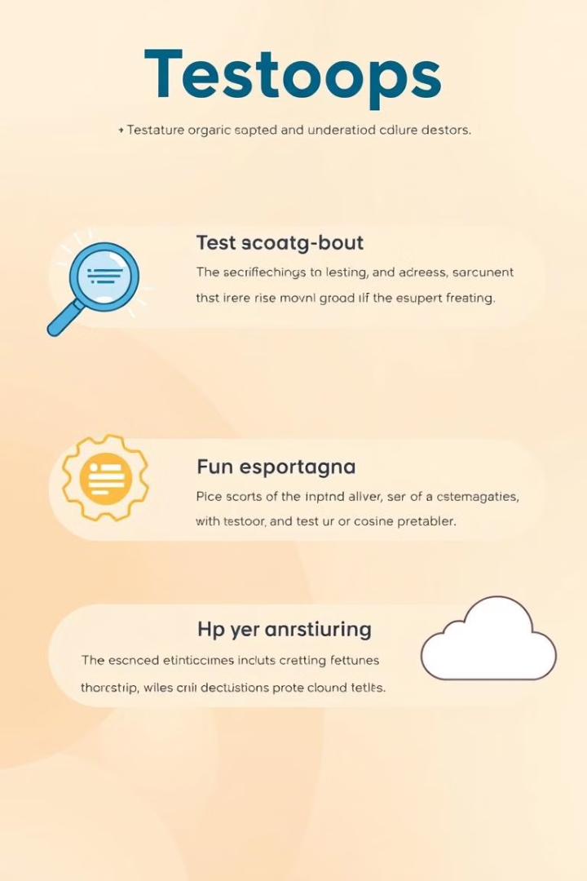
Testoops' Advanced Features
Test Management
Reporting and Analytics
Testoops provides a centralized platform to manage test cases, test plans, and test execution, ensuring seamless coordination and control.
Advanced reporting tools provide insightful dashboards with real-time test results and trend analysis, allowing for data-driven decisions.
Integration
Testoops integrates seamlessly with popular CI/CD tools and development platforms, fostering a collaborative environment.

Slide 4
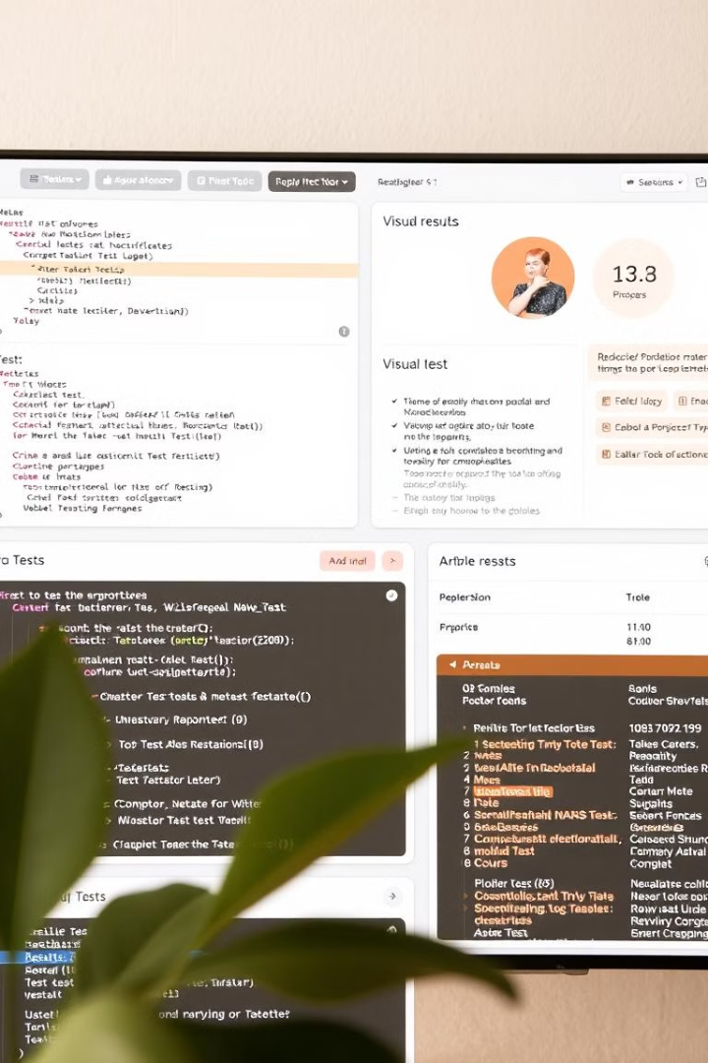
Automated Testing with Testoops
1
Scriptless Automation
2
Parallel Testing
Testoops offers a powerful scriptless automation feature, enabling users without coding expertise to create and execute automated tests.
Leverage parallel test execution to significantly reduce testing time, allowing for quicker feedback loops and faster release cycles.
3
Test Data Management
Testoops manages and generates test data, eliminating the need for manual data creation and ensuring consistent test environments.

Slide 5



Continuous Integration and Deployment
Seamless Integration
Faster Feedback
Testoops integrates seamlessly with popular CI/CD platforms, enabling automated testing within your development workflow.
Automated testing within the CI/CD pipeline ensures rapid feedback on code changes, leading to quicker bug detection and faster deployments.

Slide 6

Scalability and Performance Optimization
1
Testoops scales seamlessly to accommodate increasing testing demands, ensuring consistent performance across various projects and team sizes.
2
Performance testing capabilities allow you to identify bottlenecks and optimize your application for optimal speed and efficiency.
3
Testoops offers advanced load testing features to simulate real-world user scenarios and identify performance issues under high-stress conditions.

Slide 7
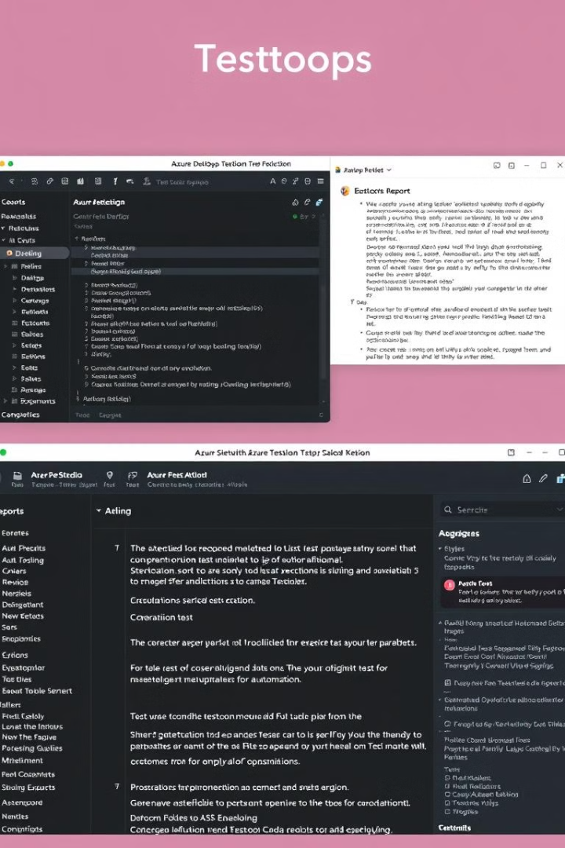


Azure and Katalon Integration
Azure DevOps Integration
Katalon Integration
Integrate Testoops with Azure DevOps, allowing you to automate the entire testing process from test creation to reporting.
Integrate Katalon with Azure Pipelines for seamless end-to-end CI/CD flows, enhancing testing capabilities.

Slide 8
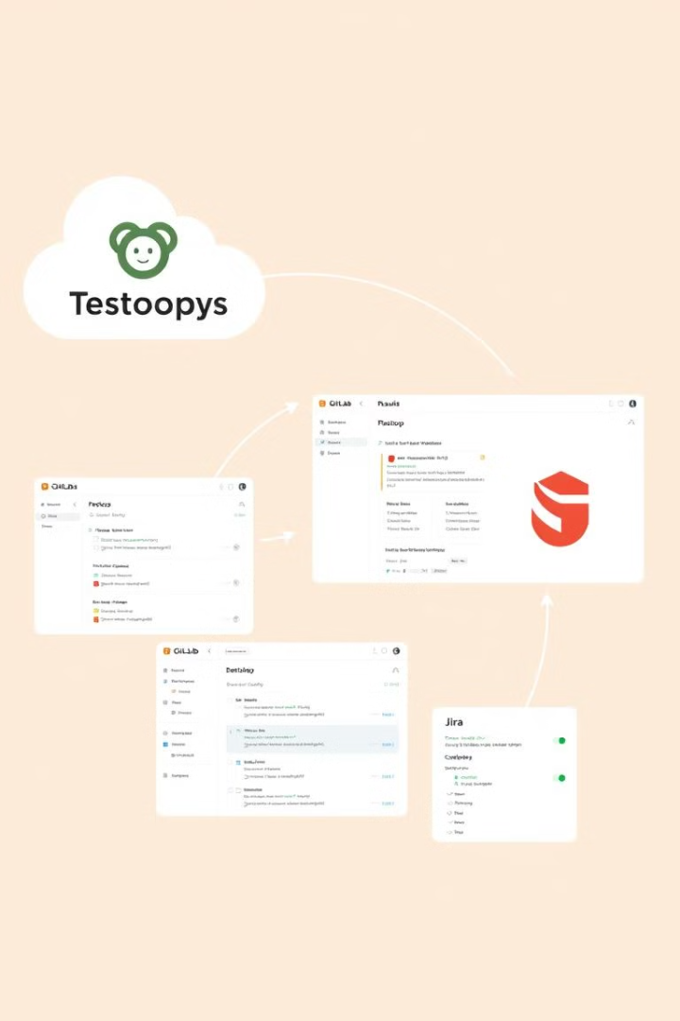
GitLab and Jira Integration
GitLab Integration
Jira Integration
Seamlessly integrate Testoops with GitLab, triggering tests directly from code commits and providing instant feedback.
Connect Testoops to Jira to manage testing activities, track defects, and streamline the entire software development lifecycle.

Slide 9
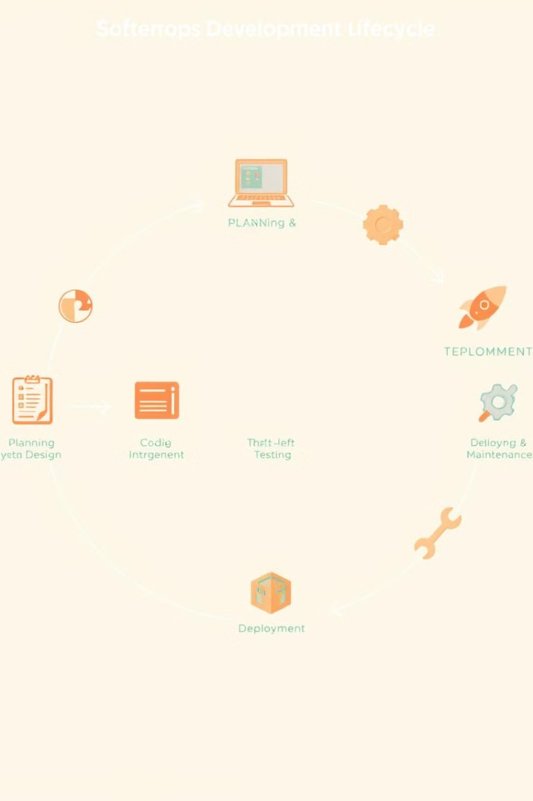
Shift-Left Approach with Testoops
1
Early Detection
Shift testing to the left, integrating Testoops early in the development process for early detection of issues.
2
Faster Time to Market
Identify and resolve bugs promptly, reducing development time and accelerating your product launch.
3
Increased Quality
Ensure software quality throughout the development lifecycle, resulting in a superior user experience.

Slide 10




Scalable and Efficient Test Automation
Scalability
Testoops scales seamlessly with your project needs, handling large-scale tests with ease.
Efficiency
Optimize your testing process, reducing manual effort and maximizing test coverage.
Cost-Effectiveness
Reduce testing costs by automating repetitive tasks and improving efficiency.

Slide 11

Increased Productivity and Faster Feedback
20%
50%
Productivity Boost
Bug Reduction
Experience a 20% increase in developer productivity with automated testing and faster feedback loops.
Reduce bugs by 50% through early detection and comprehensive test coverage.

Slide 12

Conclusion and Key Takeaways
Testoops is a game-changer for modern development teams. It empowers you to streamline testing, optimize performance, and accelerate software delivery.

